Slide 1
Outland Adventure
By Rusty Degarmo, Mitchell Kwon, Aurora Lopez,
Lucas Ramsey and Parrish Ward
https://youtu.be/rMjii_UZnck
Notes:
Introduction of Team Alpha

Slide 2

Case Study-Overview
Blythe Timmerson and Jim Ford, both outdoor enthusiasts, opened Outland Adventures.
They hired two guides; John ‘Mac’ MacNell, and D.B. ‘Duke’ Marland.
So far, they have conducted treks in Africa, Asia, and Southern Europe.
Customers may either rent or buy their equipment outright.
Notes:
Can discuss about needed supplies and guides’ general duties including in charge of organizing and planning the trips, including investigating airfares, visa requirements, and inoculations

Slide 3
Three
Do enough customers buy equipment to keep equipment sales?
Is there a downward trend in bookings?
Are there inventory items that are over five years old?
Questions?

Slide 4
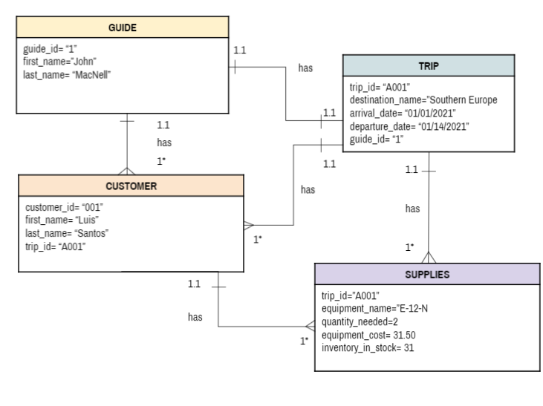
O
R
D

Slide 5
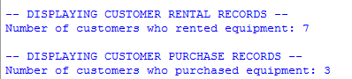
Do enough customers buy equipment to keep equipment sales?
Notes:
We created a query on the Customer table to count how many customers buy and how many rent their equipment.
Due to our anonymous data collection policy, we collected numbers and not names. We make personas to represent these
New database results=30%. Still worth it.

Slide 6
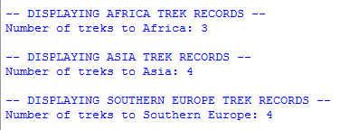
Is there a downward trend in bookings?
Notes:
We created a query on the Trip table to count how many treks there have been to each location. As you can see, based off of this months pull of the new database we have more business. However Africa’s result is misleading due to Mrs. Culligans family extending their trip.(because we have 1 more trip than listed customers)

Slide 7
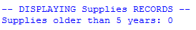
Are there inventory items that are over five years old?
Notes:
We created a query for the Supply table to count how much of the inventory is more than five (5) years old.We currently have no supplies over 5 years old. We just donated the oldest supplies to the instructor course on main.

Slide 8
Assumptions made
That the guides go on the trips as well.
The guides are both experts at all three trek locations
The business has brick and mortar locations with warehouses for supplies storage in each location
Guides already have their supplies needed for each location and will not need log their supplies in the database
The customers will not bring their own supplies to the trips they will either buy or rent
They have enough data from each location and bookings to observe trends within the data in order to make assessments

